Slide 1
Difference in Requirement of: EDA with visualization result slides (6 pts) vs EDA and interactive visual analytics methodology related slides (3 pts)

Slide 2
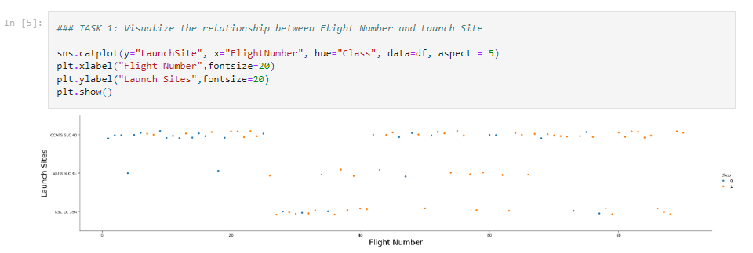
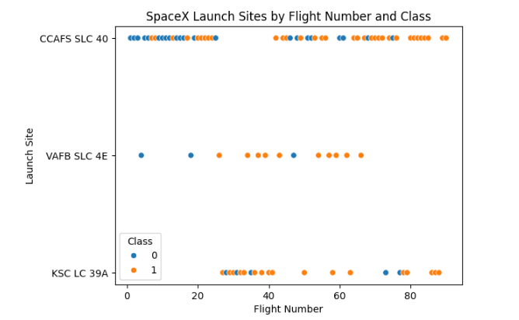
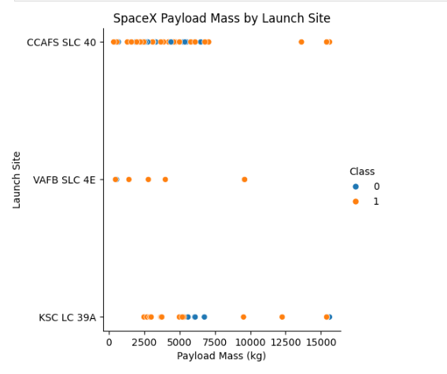

Slide 3
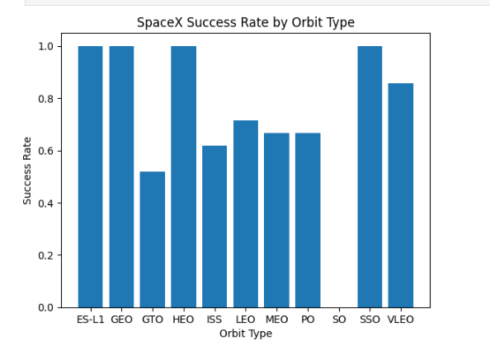
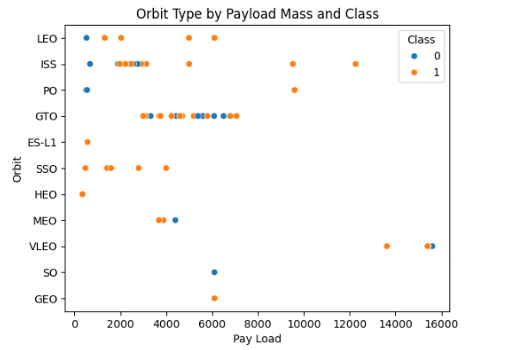
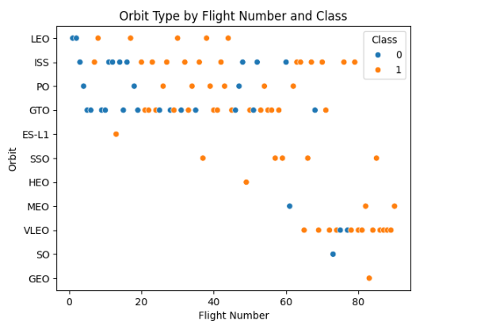

Slide 4
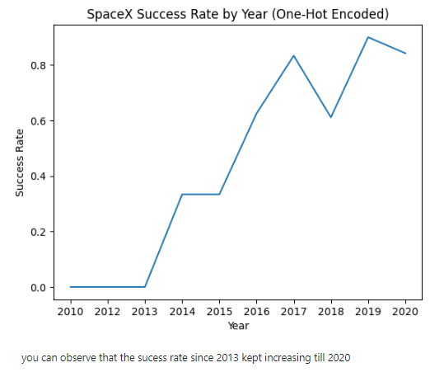
Questions to Sathya
Do I need to includes my codes?
Do I need to include also table outputs?
Too many things, report become cluttered, how ?
How to differentiate between these 2 requirements?
Why include code, if URL link is uploaded into Github?

